Slide 1

Multi-Department University Network Design Using RIP and OSPF
Course Name: Computer Networks
Course Code: BTD50112
Department: Computer Science & Engineering – Cyber Security & Data Science
University Name: Brainware University
Presented By:
Member 1 – Nabarun Kumar Maity(BWU/BTD/24/077)
Member 2 – Sneha Modak (BWU/BTD/24/122)
Member 3 – Om Kumar Gope (BWU/BTD/24/078)

Slide 2
Content
Objective with Question
Real Life Connection
Project Target and Explanation
Diagram Overview (RIP)
Demonstration & CLI (RIP)
Diagram Overview (OSPF)
Demonstration & CLI (OSPF)
Comparison
Convergence & Performance Analysis
Result & Preferred Protocol
Conclusion & Learning
Future Scope
References

Slide 3
Objective with Question
Problem Statement: How can a university connect multiple departments using dynamic routing and determine whether RIP or OSPF provides better performance?
Objectives:
  Design a multi-router university network connecting different departments.
  Configure IP addressing for routers and end devices.
  Implement and test RIP and OSPF routing protocols.
  Analyze route learning and path selection mechanisms.
  Compare convergence speed and network scalability.
  Determine the most suitable routing protocol for a university environment.
Expected Outcome: Evaluate the performance of RIP and OSPF and identify the preferred protocol for efficient inter-department communication.

Slide 4
Real Life Connection
Real-World Scenario: A university consists of three geographically separated departments:
        Academic Department
        Administrative Department
        Research Department
Each department operates on a separate LAN and requires communication with the others.
Need:
    Centralized communication.
    Reliable data transfer.
    Automatic route updates.
    Efficient network management.
Dynamic routing protocols such as RIP and OSPF are used to achieve seamless connectivity and determine the best communication path.

Slide 5
Project Target and Explanation
Project Targets:
  Design a 3-router university network in Cisco Packet Tracer.
  Configure IP addresses for routers and PCs.
  Implement RIP and OSPF routing protocols.
  Verify routing table updates and connectivity.
  Perform packet transfer testing.
  Compare the performance of both protocols.
  Identify the most suitable routing protocol.
Project Explanation: This project simulates a university network where different departments are connected through routers. RIP and OSPF are implemented separately to analyze routing behaviour, compare performance, and evaluate their suitability for inter-department communication.

Slide 6
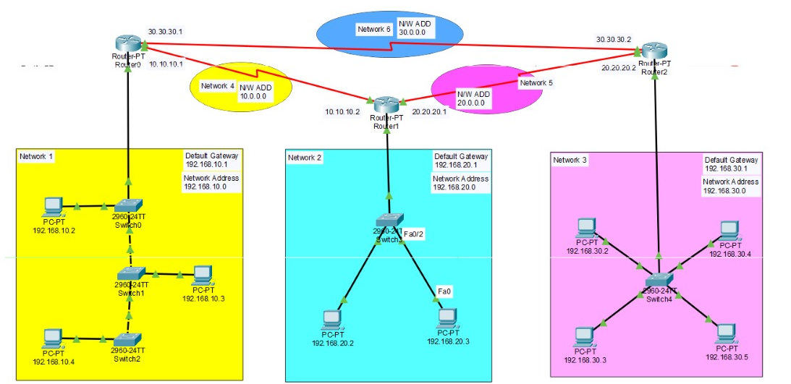
Diagram Overview (RIP)
RIP Network Topology: Three routers connect three departmental LANs.
LAN Networks:
  192.168.10.0
  192.168.20.0
  192.168.30.0
Router Links:
  10.10.10.0
  20.20.20.0
  30.30.30.0
Figure 1: University Network Topology using RIP
RIP Features:
Distance Vector Routing Protocol
Uses Hop Count metric
Periodic route updates
Working:
Routers exchange routing information.
Routes are learned automatically.
Enables communication between all departments.

Slide 7
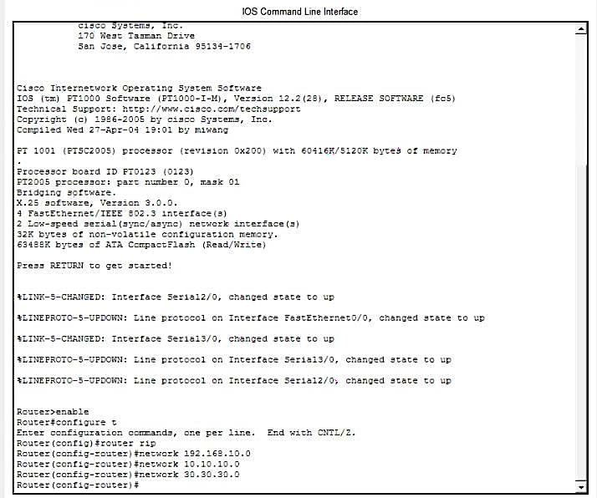
Demonstration & CLI (RIP)
RIP Configuration:
RIP configured on all routers.
Network addresses advertised successfully.
Routing information shared automatically.
Demonstration:
Routing tables updated dynamically.
Connectivity verified between departmental networks.
Successful packet delivery achieved.
Observation: RIP enabled communication between all departments through dynamic route exchange.
Figure 2: RIP Configuration and Verification using Cisco IOS CLI

Slide 8
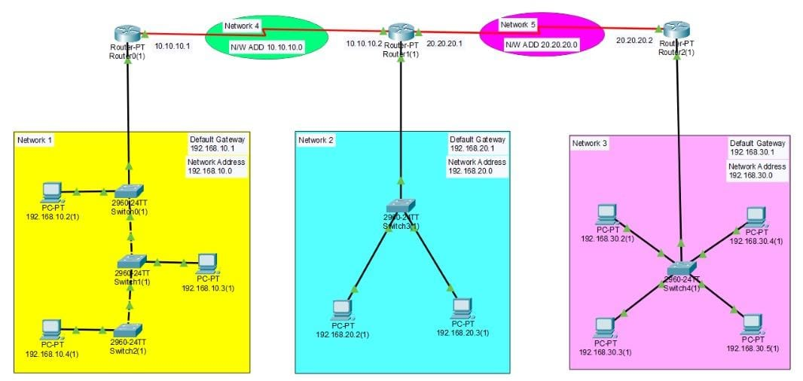
Diagram Overview (OSPF)
OSPF Network Topology: Three routers connect three departmental LANs.
LAN Networks:
  192.168.10.0
  192.168.20.0
  192.168.30.0
OSPF configured in Area 0.
OSPF Features:
Link State Routing Protocol
Uses Cost as the routing metric
Calculates the shortest path automatically
Faster convergence than RIP
Working:
Routers exchange link-state information.
Shortest path is calculated using the SPF algorithm.
Ensures efficient communication between departments.
Figure 3: University Network Topology using OSPF

Slide 9
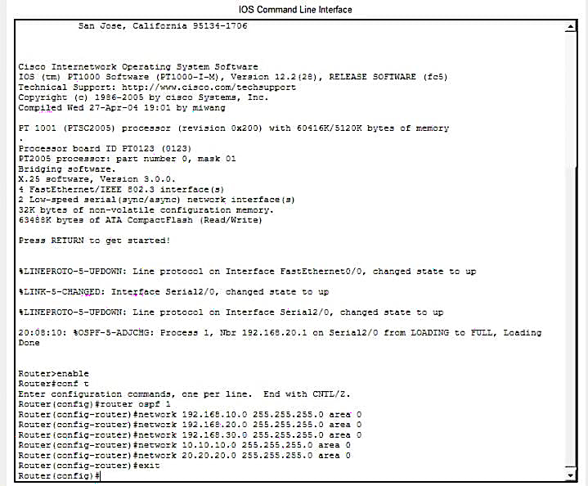
Demonstration & CLI (OSPF)
OSPF Configuration:
OSPF configured on all routers using Area 0.
Network information advertised successfully.
Neighbor relationships established between routers.
Demonstration:
Link-state information exchanged automatically.
Shortest path calculated using the SPF algorithm.
Routing tables updated dynamically.
Successful communication verified across all departments.
Observation: OSPF provided efficient routing, fast convergence, and reliable connectivity throughout the university network.
Figure 4: OSPF Configuration and Verification using Cisco IOS CLI

Slide 10
Comparison
PDU Transfer Test:
PDU sent from Academic LAN to Research LAN.
Successful packet delivery in both RIP and OSPF.
OSPF selected the optimal path more efficiently.
Parameter | RIP | OSPF
Routing Type | Distance Vector | Link State
Metric | Hop Count | Cost
Max Hops | 15 | Unlimited
Updates | Periodic | Event-Driven
Scalability | Low | High
Convergence | Slow | Fast
Observation: Both protocols provide connectivity, but OSPF offers faster convergence, better scalability, and more efficient path selection.

Slide 11
Convergence & Performance Analysis
Convergence Analysis:
RIP:
Slow convergence.
Periodic updates every 30 seconds.
Temporary routing loops may occur.
OSPF:
Fast convergence.
Immediate updates after topology changes.
Better stability.
Parameter | RIP | OSPF
Convergence Speed | Slow | Fast
Network Growth Support | Limited | Excellent
Path Selection | Hop Based | Cost Based
Reliability | Moderate | High
Enterprise Suitability | Low | High
Analysis: OSPF adapts quickly to failures and provides efficient routing decisions.

Slide 12
Result & Preferred Protocol
Results Obtained:
Network designed and configured successfully.
RIP and OSPF implemented and tested.
Routing tables generated correctly.
Successful communication between departments.
PDU transfer completed successfully.
Preferred Protocol: OSPF
Faster convergence
Better scalability
Efficient path selection
Suitable for large networks
Final Outcome: OSPF is the preferred protocol for the university network due to its better performance and scalability.

Slide 13
Conclusion & Learning
Conclusion:
A multi-department university network was successfully designed and implemented using Cisco Packet Tracer. Both RIP and OSPF enabled communication among departments. However, OSPF demonstrated superior routing efficiency, faster convergence, and better scalability, making it the preferred protocol for university networks.
Learning Outcomes:
Understood dynamic routing concepts.
Configured RIP and OSPF protocols.
Learned IP addressing and router configuration.
Analyzed routing tables and path selection.
Performed packet transfer testing.
Compared routing protocols based on real-world requirements.
— "OSPF emerges as the preferred routing protocol for large and scalable university networks due to its efficiency, scalability, and fast convergence."

Slide 14
Future Scope
The current network design can be further enhanced by implementing Multi-Area OSPF, where different departments are placed in separate OSPF areas connected through a backbone Area 0. This improves scalability and reduces unnecessary routing updates in large networks. VLSM can also be used to allocate IP addresses more efficiently and minimize address wastage.
To increase reliability, redundant links and gateway redundancy protocols such as HSRP or VRRP can be added to provide automatic failover during network failures. Security can be strengthened through ACLs and inter-VLAN routing, while IPv6 support using OSPFv3 can prepare the network for future requirements. Additionally, SNMP and NetFlow can be integrated for network monitoring, traffic analysis, and performance optimization, making the network closer to a real-world university infrastructure.

Slide 15
References
Cisco Networking Academy, CCNA: Introduction to Networks – Routing Fundamentals, Cisco Systems.
Cisco Systems, Inc., Cisco Packet Tracer Software Documentation, Cisco Systems.
B. A. Forouzan, Data Communications and Networking, McGraw-Hill Education.
G. Malkin, “RIP Version 2,” RFC 2453, IETF, 1998.
J. Moy, “OSPF Version 2,” RFC 2328, IETF, 1998.
T. Lammle, CCNA Routing and Switching Study Guide, Sybex.
Brainware University, Computer Networks – Course Code BTD50112, Study Material.
M. Jayakumar et al., “A Comparative Study on RIP and OSPF Protocols,” ICIIECS, 2015.
N. W. A. Majid and S. Fuada, “RIP vs. OSPF Routing Protocols: Which One Is the Best for a Real-Time Computer Network?” SIMETRIS, Vol. 11, No. 1, 2020.
A. Ajani et al., “Comparative Performance Evaluation of OSPF and RIP in Network Link Failure and Recovery Cases,” NIGERCON, pp. 280–288, 2017.

Slide 16
Thank you for your time and attention

